Slide 1
Welcome to the
research team!
Notes:
Course overview
This doctoral-level, academically based community service (ABCS) research seminar focuses on co-developing research questions with local youth in West Philadelphia to explore their experiences with climate change and identify potential solutions for how to mitigate, adapt to, and build resilience in the face of climate change. This course will apply frameworks and theories from climate communication, behavior change, and Youth Participatory Action Research (YPAR). Students will engage in a hands-on, youth-engaged research project and apply YPAR principles to empower youth voices in climate discourse and action.
This course provides a unique opportunity for doctoral students to gain practical experience in participatory research while addressing pressing social and environmental issues in the West Philadelphia community.

Slide 2
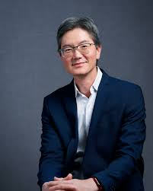
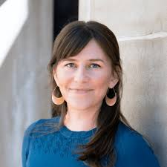

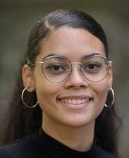
Teaching team
Andy Tan (he/him)
Dani Cosme (she/her)
Emily Falk (she/her)
Omaya Torres (she/her)
Notes:
Each person introduces themselves including information about themselves that we might put in positionality part of syllabus
Names and Pronouns. In this course, it is important that we refer to everyone by their names and by their pronouns. Pronouns can be a way to affirm someone's gender, but they can also be unrelated to a person's gender. They are simply a public way in which people are referred to in place of their name (e.g., “he” or “she” or “they” or “ze” or many others). In this classroom, you are invited but not required to share the pronouns you use (or the pronouns you want to use in this particular space), and we ask that all of us commit to being attentive to and using each other’s pronouns. If you accidentally misgender someone or use an incorrect pronoun for them, please simply correct yourself to their pronoun. If during the course you would like us to change the pronoun we are using for you, please let us know.
Name Designation. The University of Pennsylvania is committed to providing an equitable and safe experience for students whose birth name and/or legal name does not reflect their gender. Any student, including transgender, genderfluid, genderqueer, gender diverse, non-cisgender and cisgender students who wish to designate a name different from their birth or legal name can do so by editing their Personal Information page in Path@Penn. For additional Preferred First Name, Pronouns, and Gender Identity Information, see https://srfs.upenn.edu/student-records/update-data.
Bathrooms in Annenberg. Two all-gender bathrooms are located on the second floor. The first one is ADA-compliant and includes a diaper changing table. The second one has three toilets, one of which is ADA-compliant. Four single-use all-gender bathrooms are located on the first floor of the Annenberg School, through the double doors next to the main elevator. Two additional single-use all-gender bathrooms are located on the fifth floor outside room 500. Free sanitary products are available in the all-gender bathrooms of the LGBT Center, 3907 Spruce St. Please let your instructor know if you require other information about spaces of accommodation.

Slide 3
Student intros
Notes:
Name, program, briefly why did you sign up?

Slide 4
Syllabus
Notes:
20 mins

Slide 5
Course objectives
Understand core theories about behavior change, communication intervention design, and YPAR.
Design and implement a study, using qualitative and/or quantitative research techniques to conduct formative research, message design, and testing focused on climate and health/well being in partnership with youth.
Develop proficiency in data analysis, interpretation, and presentation of findings.
Understand the ethical and practical considerations in youth-centered research, relationship building, community engagement strategies, and effective facilitation skills.

Slide 6
Course structure
Two sessions each week: in-class sessions (Thursdays 9:30-11:30AM) and youth engagement sessions (Wednesdays 9:25-10:55AM at Sayre High School)
In-class sessions will typically be divided as follows:
55 minute class discussion of weekly readings
10 minute break
55 minute planning / co-working session to prepare for youth engagement sessions and debrief the previous session
Youth engagement work will include ~2.5 hours/week (outside of class time and based on availability) facilitating the research study development with your team. The day/time of engagement visits are on Wednesdays 9:25-10:55AM. Please plan to arrive around 9:15AM to ensure we can begin promptly at 9:25AM.
Engagement sites will be at Sayre High School in Ms. Schwalm’s 12th grade civics class. We understand there may be scheduling conflicts. Please let us know as soon as possible if this is an issue.

Slide 7
Course structure
To gain experience with facilitation, graduate students will facilitate class discussions in weeks 5-13. The goal is to help students become more comfortable with facilitation and navigating conversations in which people have different views. Although this is one of the course assignments, it will be graded pass/fail and should not feel socially evaluative. Instructors will lead discussions weeks 1-4 and model facilitation strategies.
Wherever possible, we will strive to put principles from YPAR—community building, deep listening, consensus decision making—in practice during in-class sessions. In addition to helping promote a positive classroom culture, this will enable us to practice the processes we’ll use with high school students during engagement sessions.
As this course will include working with community partners, we ask for your flexibility over the semester if there are changes in the schedule.

Slide 8
HR Clearances
The Netter Center will be organizing a clearance blitz the week of January 27th.
FOR INTERNATIONAL STUDENTS ON A (F-1/J-1) VISA: Information is coming soon
FOR DOMESTIC (NON-INTERNATIONAL) STUDENTS
STEP 1: Visit 3401 Walnut Street, Room 329-A (the Max Kade Center) during one of the following time slots. Expect to stay for ~30 minutes. You do not need to sign up for a time in advance. You must know your Social Security Number, and bring your laptop and PennCard.
Monday, January 27th, 9:30AM – 2:30PM
Tuesday, January 28th, 9:30AM – 2:30PM
Wednesday, January 29th, MAX KADE CENTER CLOSED - NO APPOINTMENTS
Thursday, January 30th, 9:30AM – 2:30PM
Friday, January 31st, 9:30AM – 1:00PM
During this visit, you will receive your PATCH - PA Criminal History Search and your PA Child Abuse background checks. You will also sign up for an IdentoGO fingerprinting appointment for your FBI clearance.
STEP 2: Attend your scheduled fingerprinting appointment at the location designated in your IdentoGO confirmation email. Your FBI clearance will be sent by email 24 hours after your fingerprinting appointment. Send a PDF copy to: myetunde@upenn.edu and backgroundchecks@hr.upenn.edu.
We have authorization codes we can provide after class so you can schedule this before the clearance blitz
STEP 3: If you are working with a School District of Philadelphia school, complete the 3-hour mandated reporter training by following these instructions.
More info about the process can be found here: https://www.nettercenter.upenn.edu/what-we-do/abcs-courses/clearances-abcs
If you have completed this process in the past 5 years, email myetunde@upenn.edu and backgroundchecks@hr.upenn.edu to verify your status before the blitz

Slide 9
Assignments
Complete weekly readings and post reflections on canvas before class [20%]
Graded pass/fail based on completion each week
Write 1-2 paragraphs reflection on the readings and raising questions for in class discussion
Prepare for and facilitate a discussion about the weekly readings [10%]
Graded pass/fail
Read and synthesize student reflections on canvas, generate discussion questions, and facilitate the in class discussion
Active participation in youth engagement activity planning, preparation, and implementation [30%]
Graded pass/fail based on completion each week
Work with co-facilitators to plan the youth engagement session, facilitate the session, and complete the debrief worksheet
Final paper outline [5%]
Graded pass/fail based on completion
Outline final paper in order to receive feedback from instructors
Final paper [20%]
Graded assignment
Instructions will be posted on canvas
Presentation with youth partners [15%]
Graded assignment
Instructions will be posted on canvas
Notes:
Ask students about when reflections should be posted by (proposal = Wednesdays at 9AM)

Slide 10
Schedule (youth sessions & seminar sessions)
January 22 (ASC 223) – no youth session Netter orientation + presentation on Philly schools with Zac Steel | January 23 YPAR & positive youth development
January 29 (ASC 223) – no youth session Community building, community agreements, navigating conflict w/ Imani Hester from Restorative Practices at Penn | January 30 Climate & HS topics
February 5 Relationship building | February 6 Behavior change theory & interventions
February 12 Relationship building | February 13 Communication theory & interventions
February 19 Brainstorm | February 20 Ethical considerations
February 26 Planning | February 27 Role of theory in developing communication interventions
March 5 Planning | March 6 Formative research

Slide 11
Schedule (youth sessions & seminar sessions)
March 12 Canceled: Penn spring break | March 13 Canceled: Penn spring break
March 19 Implementation | March 20 Message co-design
March 26 Implementation | March 27 Climate & youth health
April 2 Synthesis & summary | April 3 Climate communication & action
April 9 Synthesis & summary | April 10 Youth climate communication & action
April 16 (ASC 223) – no youth session (Sayre spring break) Reflections and Q&A with Ira Harkavy | April 17 Climate equity & policy; integration w/ students' research programs
April 23 Presentation prep | April 24 Collective retrospective
April 30 Presentation + celebration

Slide 12
Statement on soliciting feedback
At Penn and in this course, we aim to educate and respect students with diverse backgrounds and perspectives. The diversity students bring to class is a resource and an essential feature of university education. We aim to present materials and activities that are respectful of diversity, including academic background as well as gender, sexuality, disability, age, socioeconomic status, ethnicity, race, and culture. Your suggestions to improve diversity and inclusivity in the course are encouraged and appreciated.

Slide 13
Course policies
Attendance/Participation. One of the objectives for this course is developing relationships with community partners. Participatory research depends on relationships—on establishing trust and a sense of community within our class and on site. Missing meetings or showing disrespect in any way has consequences for the young people we work with, and for the sustainability of these partnerships. This means showing up to both class and your engagement work is essential. What does it mean to show up?
Be present, both physically and mentally. Your class participation grade will be lowered if you miss or show up late to class or engagement without communicating with me. Your grade will also be lowered if you are seen texting, using social media, or emailing during class or at your engagement site (unless these are part of the work itself).
Engage respectfully: Be willing to share your ideas and experiences with others. This is an environment where everyone should feel comfortable participating. In class and at the engagement site, use “I” statements when speaking, step up/ step back, and give others the benefit of the doubt.
Honor partner relationships: We are guests in our engagement sites. Be respectful of both youth partners and adult staff—their workload, experience, and knowledge—as well as site norms and rules. Dress professionally; communicate professionally; act professionally. Remember you are coming from an educational institution with tremendous resources. The partners we work with may be coming from different contexts. Partner relationships and mental health should always be prioritized over a deadline. Please communicate with us as early as possible if you experience any difficulty.
Cell Phone/ Electronic Devices: Out of respect for each other and the learning environment, the use of cell phones, pagers, and other electronic devices are not permitted in the classroom and when you are engaging with partners at the engagement sites. Please keep them off (not silent, not vibrate, but OFF) during class time.

Slide 14
Course policies
CITI training for human subjects’ research: This training is required for all students involved in conducting human subjects research in this class. For students who have not done so, complete Human Subjects Research Training (choose social/behavioral research track) https://irb.upenn.edu/mission-institutional-review-board-irb/guidance/citi-human-research-protections-training as soon as possible. Netter Center has obtained IRB approval for research conducted at the engagement sites. Familiarize yourself with submitting new human subjects research for approval by Penn IRB. https://irb.upenn.edu/initial
Netter Center Student Handbook. More information about the Netter Center for Community Partnerships, ABCS courses, University-Assisted Community Schools, and engagement expectations can be found in the Student Handbook: https://bit.ly/netter-handbook
Communication with instructors. When emailing or sending messages to instructors on Canvas, please include all instructors as the default. If you want to communicate with specific instructors only, you do not need to include the others.
Notes:
Ask about communication on slack

Slide 15
Course policies
Google Drive. A Google Drive folder has been created to facilitate saving your team’s work and to provide in-class feedback during workshops. The link to the folder is: https://bit.ly/ccc-google-drive
Late and Make-up Work: Please contact us if you anticipate a delay for submitting any of the assignments so that we can plan on a workaround.
Student Accessibility: Please refer to the following resource and notify the instructor regarding accommodations. https://wlrc.vpul.upenn.edu/sds
Academic Integrity: Students are expected to adhere strictly to the University’s Code of Academic Integrity. All individual work submitted for this course are expected to be the student’s individual and original work. Material obtained from another source must be appropriately acknowledged and cited. Other important guidelines are listed in the University’s policy on academic integrity, which can be viewed at https://catalog.upenn.edu/pennbook/code-of-academic-integrity
Use of generative AI tools. In this course, generative AI tools (e.g. chatGPT) are only permitted for preparatory work such as brainstorming, generating initial versions of climate & health solutions, or other such tasks as specified by course instructors. All written assignments should be your own original work, created for this class. Written work created by generative AI tools is not considered as original work. It is worth noting that generative AI tools can sometimes generate information that may be inaccurate, incomplete, or otherwise problematic. It is your responsibility to fact-check and proofread all the information you receive from AI tools.

Slide 16
Positionality statement
In this course we will be reading work from a range of scholars, engaging with school partners, and with youth whose position, privilege, commitments, and lived experiences may be vastly different from our own. Together, our goal in this class is to come to these texts and engagement sessions with mutual respect and an eagerness to learn. Our identities influenced how we approached the development of this course and communication research.
We are socialized into an unjust and unequal society, and we inherit biases woven into the fabric of that society. We aim to approach the course (and its diverse content) in a way that prioritizes the needs and well-being of scholars from historically and currently marginalized groups. We can do this by listening to our colleagues, fellow students, and community partners, practicing intellectual humility, and being actively curious about our biases, blindspots, and areas of ignorance.

Slide 17
Inclusivity & accessibility
Names and Pronouns. In this course, it is important that we refer to everyone by their names and by their pronouns. Pronouns can be a way to affirm someone's gender, but they can also be unrelated to a person's gender. They are simply a public way in which people are referred to in place of their name (e.g., “he” or “she” or “they” or “ze” or many others). In this classroom, you are invited but not required to share the pronouns you use (or the pronouns you want to use in this particular space), and we ask that all of us commit to being attentive to and using each other’s pronouns. If you accidentally misgender someone or use an incorrect pronoun for them, please simply correct yourself to their pronoun. If during the course you would like us to change the pronoun we are using for you, please let us know.
Name Designation. The University of Pennsylvania is committed to providing an equitable and safe experience for students whose birth name and/or legal name does not reflect their gender. Any student, including transgender, genderfluid, genderqueer, gender diverse, non-cisgender and cisgender students who wish to designate a name different from their birth or legal name can do so by editing their Personal Information page in Path@Penn. For additional Preferred First Name, Pronouns, and Gender Identity Information, see https://srfs.upenn.edu/student-records/update-data
Bathrooms in Annenberg. Two all-gender bathrooms are located on the second floor. The first one is ADA-compliant and includes a diaper changing table. The second one has three toilets, one of which is ADA-compliant. Four single-use all-gender bathrooms are located on the first floor of the Annenberg School, through the double doors next to the main elevator. Two additional single-use all-gender bathrooms are located on the fifth floor outside room 500. Free sanitary products are available in the all-gender bathrooms of the LGBT Center, 3907 Spruce St. Please let your instructor know if you require other information about spaces of accommodation.

Slide 18
Youth Participatory Action Research (YPAR)
Notes:
10 mins - Key principles of Youth Participatory Action Research (YPAR)

Slide 19
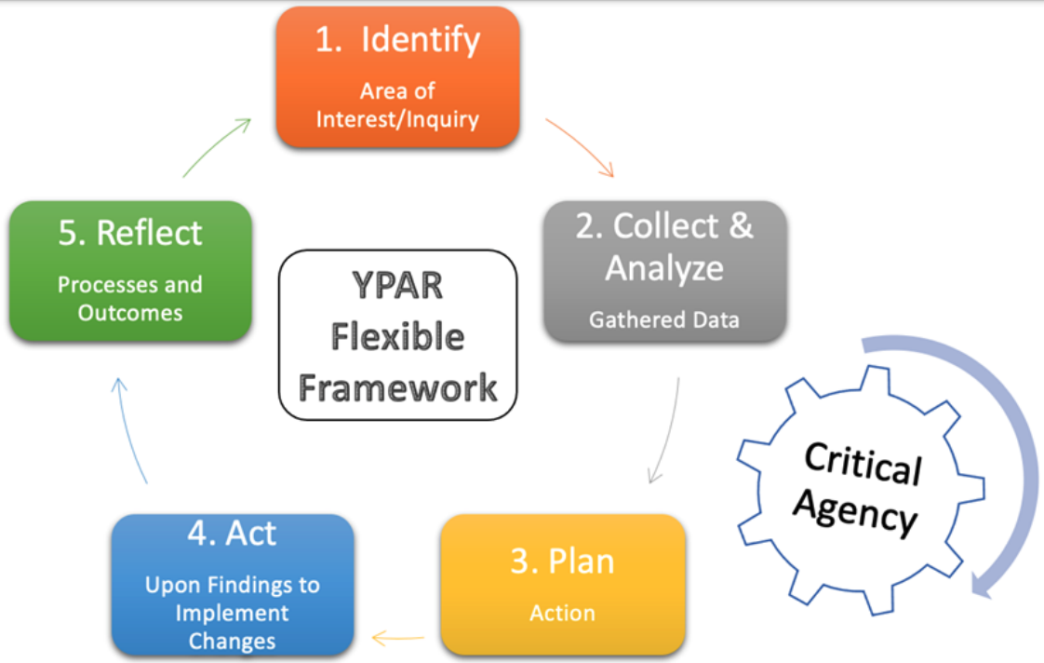
What is YPAR?
Figure from Equity By Design
Notes:
Form of CBPR, iterative framework within which youth can work together and use research methods to solve real-world problems important to them → increasing critical consciousness about community issues and agency to improve them
Goal = increase knowledge to act effectively
Can be youth-led or in partnership with adults, who facilitate and provide training

Slide 20
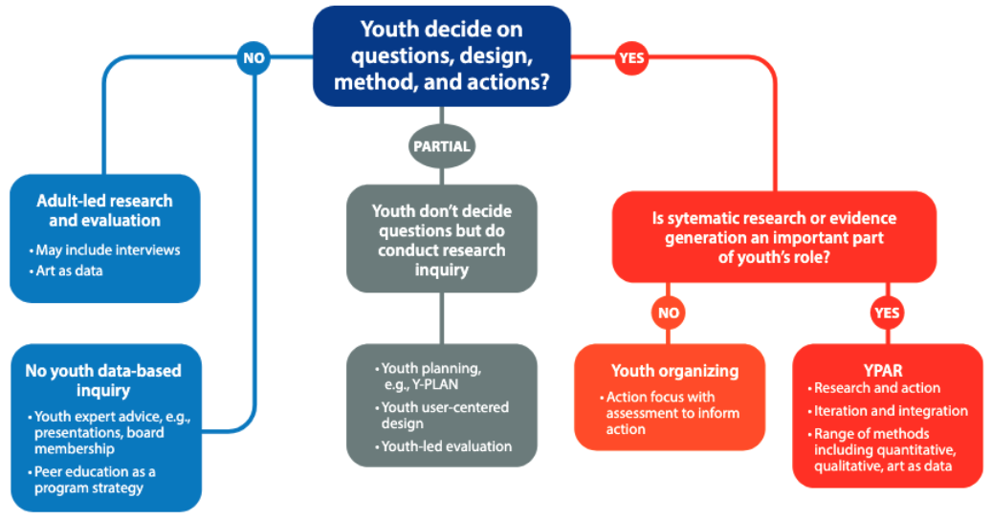
How is YPAR unique?
Figure from Ozer, E. J., et al. (2024). Youth-Led Participatory Action Research and Developmental Science: Intersections and Innovations Download Youth-Led Participatory Action Research and Developmental Science: Intersections and Innovations. Annual Review of Developmental Psychology, 6(1), 401-423.
Notes:
Youth are involved in all stages of the process → “No research about us without us” is an essential value
Power is shared and youth expertise from their lived experience is honored and centered
Each of these types of research with youth has a place; not everything has to be YPAR and we can think critically about which approach is best suited to the project goals

Slide 21
Principles of YPAR
Wingspread Declaration of Principles for Youth Participation in Community Research & Evaluation
Youth participation in community research and evaluation transforms its participants. It transforms our ways of knowing, the strategies we devise, the methods we employ, and our program of work.
Youth participation promotes youth empowerment. It recognizes the experience and expertise of all young people, and respects their leadership capacities and potential contributions.
Youth participation builds mutually liberatory partnerships. It values the assets of all ages, and fosters supportive and respectful youth/youth and youth/adult working relationships.
Youth participation equalizes power relationships between youth and adults. It establishes a level playing field clarifying for participants the purpose of the process and the power imbalances between groups. It structures environments that respect the involvement of young people, and train adults in supporting genuine youth decision-making and leadership development.
Youth participation is an inclusive process that recognizes all forms of democratic leadership, young and old. It involves diverse populations and perspectives, especially those who are traditionally underserved and underrepresented.
Youth participation involves young people in meaningful ways. Young people participate in all stages of the process, from defining the problem, to gathering and analyzing the information, to making decisions and taking action.
Youth participation is an ongoing process, not a one-time event. Participants continuously clarify and reflect upon its purpose and content. Research and evaluation are viewed as an integral part of knowledge development, program planning, and community improvement.
School of Social Work (2002). University of Michigan. Summary of proceedings. Wingspread symposium on youth participation in community research https://ssw.umich.edu/sites/default/files/documents/research/projects/youth-and-community/SymposiumII.pdf

Slide 22
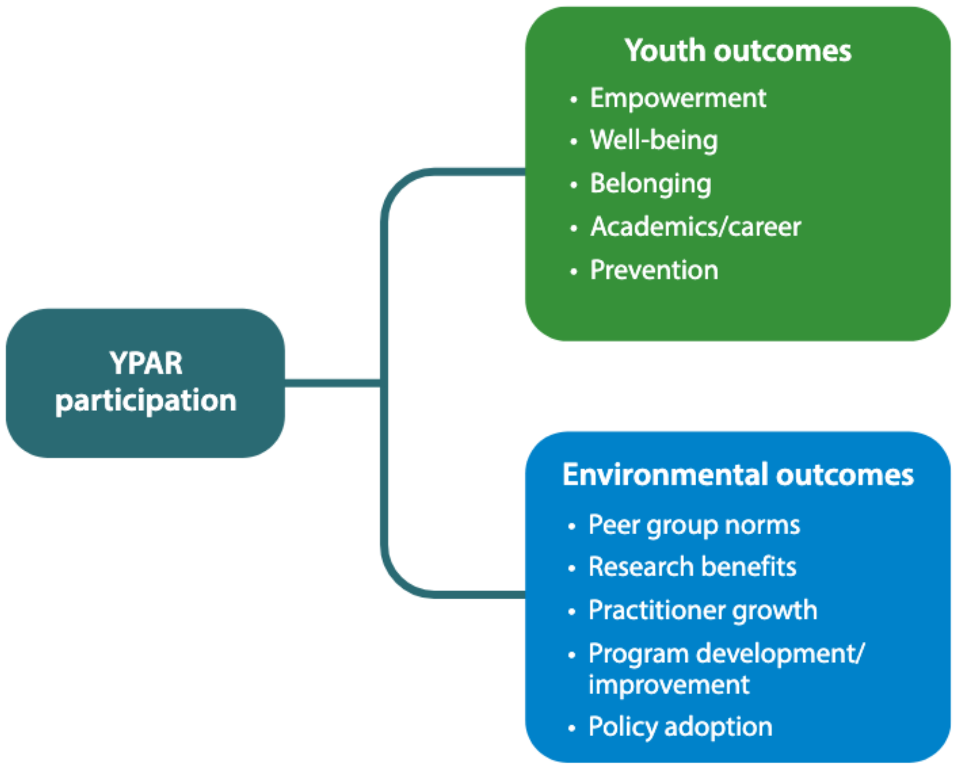
Why YPAR?
Figure from Ozer, E. J., et al. (2024). Youth-Led Participatory Action Research and Developmental Science: Intersections and Innovations Download Youth-Led Participatory Action Research and Developmental Science: Intersections and Innovations. Annual Review of Developmental Psychology, 6(1), 401-423.
Notes:
Ballonoff et al. (2024):
Youth: agency and leadership, academic achievement, career preparation, sense of belonging, civic engagement, empowerment, and wellbeing. Additional outcomes: self-efficacy, resilience, self-esteem, social connection, and social skills. YPAR also helps strengthen their peer networks.
Adults: Changing attitudes and beliefs related to sharing power and partnering with youth.
Programs, policies and research: Youth friendly programs and policies; research better reflects youth reality; expanded audience of who hears and takes action

Slide 23
Ethical frameworks
Notes:
10 mins - Andy

Slide 24
Principles
Belmont Report (1974) & Menlo Report (2010)
•Respect for Persons e.g., Autonomy, Beneficence/ Non-maleficence, Justice
•The Common Rule
•Respect for Law and Public Interest
Other ethical frameworks: Communication ethics, Advertising (TARES), Social marketing
Diversity of culture, moral values, norms vs. Western ethical precepts
Unique ethical issues in YPAR
The Routledge Handbook of Health Communication (Chapter 34): https://doi.org/10.4324/9781003043379

Slide 25
Autonomy and Respect for Persons
People are to be treated as independent and autonomous individuals; The well- being of those who are not in a position to be fully autonomous should also be protected
Vulnerable populations – Including children, prisoners, and people with impaired cognitive capacity.
Assent – A child has affirmatively agreed to participate in a study, not absence of objection, depends on developmental level of child
Informed consent – 3 key domains of information about procedures and risks, comprehension, and voluntariness; individual consent vs. community consent
CBPR/CEnR – Participants are actively involved in research, protection from objectification and dehumanization

Slide 26
Beneficence and non-maleficence
Your study must “should not injure one person regardless of the benefits that might come to others” and must maximize possible benefits and minimize possible harms.
In practice: a risk/benefit analysis and then a decision about whether the risks and benefits strike an appropriate ethical balance
Reporting back results to participants who want them – potential harms and benefits of uncertain or unfavorable findings, conflict between respect for persons and autonomy vs. beneficence, conflict between individual and community interests

Slide 27
Justice and Equity
Addresses the just and fair distribution of the burdens and benefits of research
Who bears the burden of research? Who reaps the benefits of research & interventions arising from the research?
Protection of vulnerable people from researchers
Ensuring equitable access to research so underrepresented groups benefit from knowledge gained
Appropriate compensation for participants?
Engage all stakeholders on ethical conduct of research, obtaining IRB and also community approvals, disclosure of results

Slide 28
Unique ethical issues in YPAR
Recommendations
1. Consult youth with regards to their extent of participation, include youth in as many aspects as is feasible
2. Researchers critically reflect on their role as expert, recognize power imbalances, and actively engage in equalizing power during research process
Level of participation
Equalizing power
Consent
Balancing risk:benefit ratio
Confidentiality and anonymity
Remuneration
Empowerment
Cullen, O., & Walsh, C. A. (2020). A Narrative Review of Ethical Issues in Participatory Research with Young People. YOUNG, 28(4), 363-386. https://doi.org/10.1177/1103308819886470

Slide 29
Unique ethical issues in YPAR
Recommendations
3. Regard youth consent as an ongoing process, based on capacity and not just biological age
4. Be mindful in balancing primacy of youth participation with youth protection, involving youth in these discussions of risks and benefits
Level of participation
Equalizing power
Consent
Balancing risk:benefit ratio
Confidentiality and anonymity
Remuneration
Empowerment
Cullen, O., & Walsh, C. A. (2020). A Narrative Review of Ethical Issues in Participatory Research with Young People. YOUNG, 28(4), 363-386. https://doi.org/10.1177/1103308819886470

Slide 30
Unique ethical issues in YPAR
Recommendations
5. Need increased flexibility in relaxing anonymity to increase participation, empowerment of youth within research
6. Consider other forms of remuneration beyond monetary forms, caution against increased risk or coercion
Level of participation
Equalizing power
Consent
Balancing risk:benefit ratio
Confidentiality and anonymity
Remuneration
Empowerment
Cullen, O., & Walsh, C. A. (2020). A Narrative Review of Ethical Issues in Participatory Research with Young People. YOUNG, 28(4), 363-386. https://doi.org/10.1177/1103308819886470

Slide 31
Unique ethical issues in YPAR
Recommendations
7. Thoughtfully incorporate concepts of empowerment into the research design and practices
Level of participation
Equalizing power
Consent
Balancing risk:benefit ratio
Confidentiality and anonymity
Remuneration
Empowerment
Cullen, O., & Walsh, C. A. (2020). A Narrative Review of Ethical Issues in Participatory Research with Young People. YOUNG, 28(4), 363-386. https://doi.org/10.1177/1103308819886470

Slide 32
Our core motivations
What do you hope to gain in this course?
What would success look like for you?
What are you excited about?
Notes:
Ice breaker; What do you hope to gain, what would success look like for you?
Interests vis Ms. Schwalm interests

Slide 33
What expertise and experiences
do you think will enhance your
contribution to the team?

Slide 34
What challenges are you concerned about?
Are there particular kinds of support you are hoping for from the team?

Slide 35
Interests of Sayre students

Slide 36
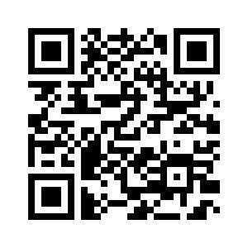
9 | Gun Violence
3 | Mental Health
2 | Homelessness/Housing Access
2 | Community Cleanup
1 | Substance Use
1 | Women's Health (access to menstrual products and access to care)
1 | Food Security/Access to good foods
1 | Police Brutality
1 | Poverty
1 | LGBTQ Rights
Student social media posts: https://jschwalm4.wixsite.com/civics-instagram-fee
Notes:
How might we form three topic clusters?

Slide 37
Getting to know our partners

Slide 38
What would you like to know about the Penn students/professors who will be coming into our classroom?
What did they major and minor in?
What are they studying? Do they like it?
What makes them interested in coming to Sayre?
Why did they pick their field of study?
How did they pick their job?
What advice would you give to students going to college?
What do the professors teach?
What made them want to get more into science and climate change?
How will this benefit us?

Slide 39
What do you want the Penn students/professors to know about you before they come into the classroom?
Drayton: I want them to know that I want to join the health-care field.
Asiyah: I would like them to know that I aspire to study journalism and psychology in college.
Makayla: I would like them to know that I am very energetic and very nice.
Semaj: I want them to know that I would take the ideas they give me to help me improve.
Zakia: I would want them to know that I have been in Penn programs before working and researching so I know a lil something.
Kiyra: I want them to know that I laugh a lot and that I’m not very good at explaining myself.
Darius: I want them to know that I listen very well
Aminah: I want them to know that if they don’t make it fun and interesting I won’t interact, nor pay attention.
Mercedes: I want them to know that I have big goals.
Giavanni: I would want them to know that I’m a good listener and I’ll ask questions if I have to
Sonoyah: Science topics aren’t really my thing but I always wanted a better understanding of climate change.
Sameerah: I want them to know that I’m excited to meet them
Asiya: I want them to know that I want to be a RN once I graduate college

Slide 40
Wingspread Declaration of Principles for Youth Participatory Research & Evaluation (cont’d)
Youth participation is an inclusive process that recognizes all forms of democratic leadership, young and old. It involves diverse populations and perspectives, especially those who are traditionally underserved and underrepresented.
Youth participation involves young people in meaningful ways. Young people participate in all stages of the process, from defining the problem, to gathering and analyzing the information, to making decisions and taking action.
Youth participation is an ongoing process, not a one-time event. Participants continuously clarify and reflect upon its purpose and content. Research and evaluation are viewed as an integral part of knowledge development, program planning, and community improvement.
School of Social Work (2002). University of Michigan. Summary of proceedings. Wingspread symposium on youth participation in community research http://www.ssw.umich.edu/public/currentProjects/youthAndCommunity/pubs/SymposiumII.pdf

Slide 41

What are key principles for engaging community partners and youth in research?
•Bring youth actively and intentionally as partners into the training and practice of research, critical thinking, and change strategy
•Integrate their ideas, perspectives, and skills and strengths into the design & implementation
•Attend to intentional power sharing between youth and adults
•Integrate research and action phases into the project
•Inclusive and mutual respect
•Value each other’s contributions
•Self-awareness, reflection, dialogue
•Monitor and evaluate how the partnership is going
Ozer EJ, Piatt AA. Youth-led participatory action research (YPAR). In: Community-Based Participatory Research for Health: Advancing Social and Health Equity. 3rd edition. Jossey-Bass; 2017.

